Slide 1
Capstone Project-3
Email Campaign Effectiveness Prediction

Slide 2
Team Name: Web Crawlers
Rajat Chaudhary
Anukriti Shakyawar
Raman Kumar
Deepmala Srivastava
Kritisha Panda

Slide 3
Content
Problem statement
Data Summary
Data Cleaning
Imputing missing values
Analysis of categorical features
Analysis of Continuous features
Outlier treatment
Feature Engineering
Understanding target variable
Handling Imbalanced data.
Different Models
Challenges
Conclusion

Slide 4
Introduction
Direct email marketing represents a crucial moment along the customer journey where a sequence of optimized messages could influence customer decisions. Not only this optimization process may lead to revenue growth but it also promotes a fruitful customer engagement and satisfaction over a long time period. In this project, we propose a machine learning based approach to characterize the mail and track the mail that is ignored; read; acknowledged by the reader.

Slide 5
Problem statement
Most of the small to medium business owners are making effective use of Gmail-based Email marketing Strategies for offline targeting of converting their prospective customers into leads so that they stay with them in Business.
The main objective is to create a machine learning model to characterize the mail and track the mail that is ignored; read; acknowledged by the reader

Slide 6
Data Summary
The dataset comprised of 12 features including the target variable Email_Status.
The 5 numerical variables were :
Word_Count
Total_Past_Communications
Subject_Hotness_Score
Total_Links
Total_Images
The 5 categorical variables were:
Email_Type
Email_Source_Type
Customer_Location
Email_Campaign_Type
Time_Email_Sent_Catergory
The total no. of records in our dataset is 68353

Slide 7
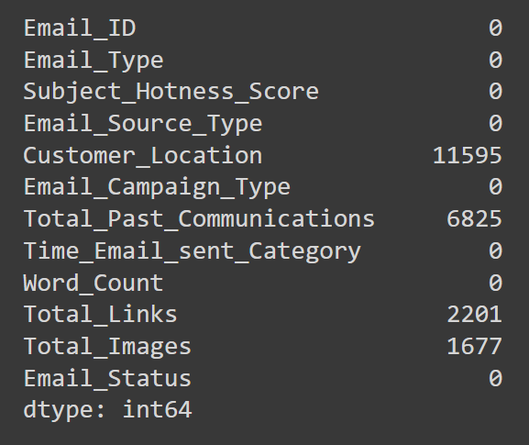
Data Cleaning
Null Value Imputation:

Slide 8
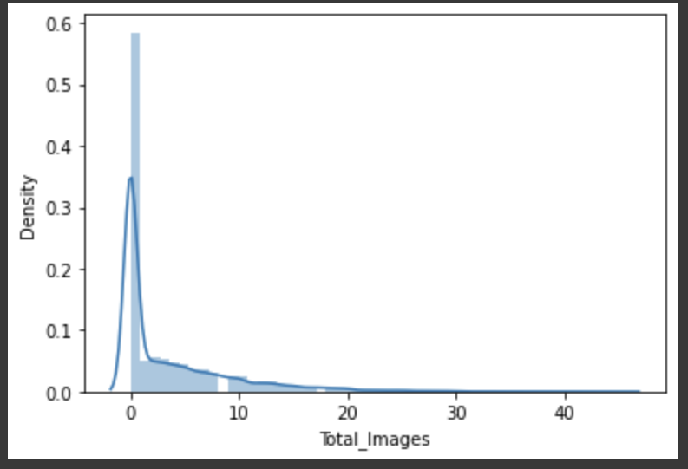
Imputing Missing Values
Impute the missing values for Total_Past_Communication by the mean
Impute the missing values for Total_Links & Total_Images by the mode

Slide 9
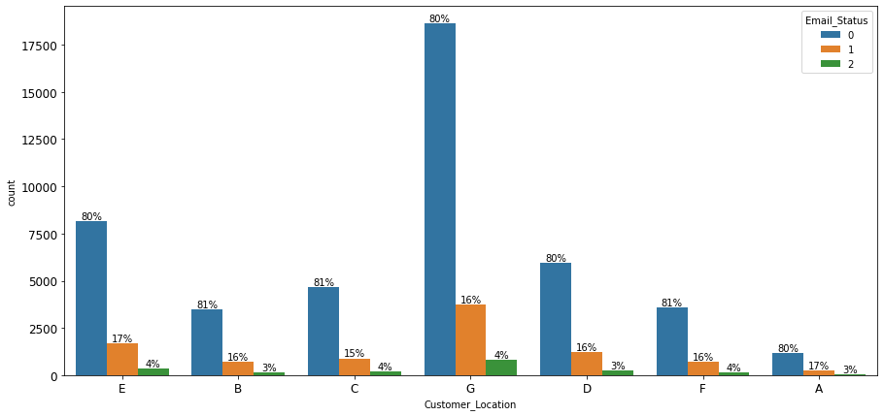
Analysis of Categorical Features
Customer_Location w.r.t Email_Status
Inference: same ratio of Email_Status for different demographic

Slide 10
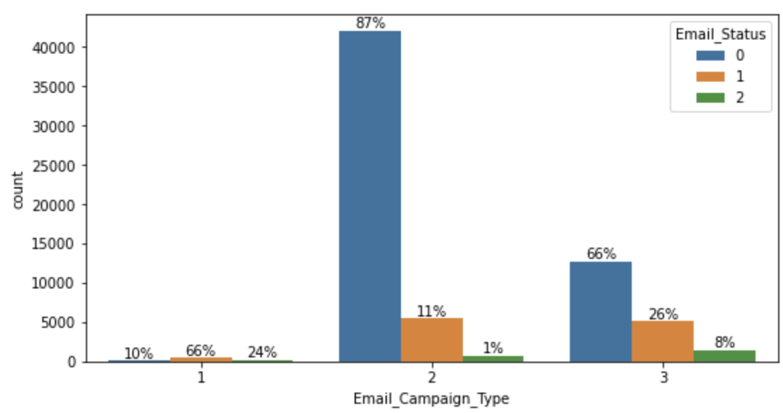
Analysis of Categorical Features
Email_Campaign_Type w.r.t Email_Status
90% of the time Email gets read or acknowledged if Campaign_Type is 1

Slide 11
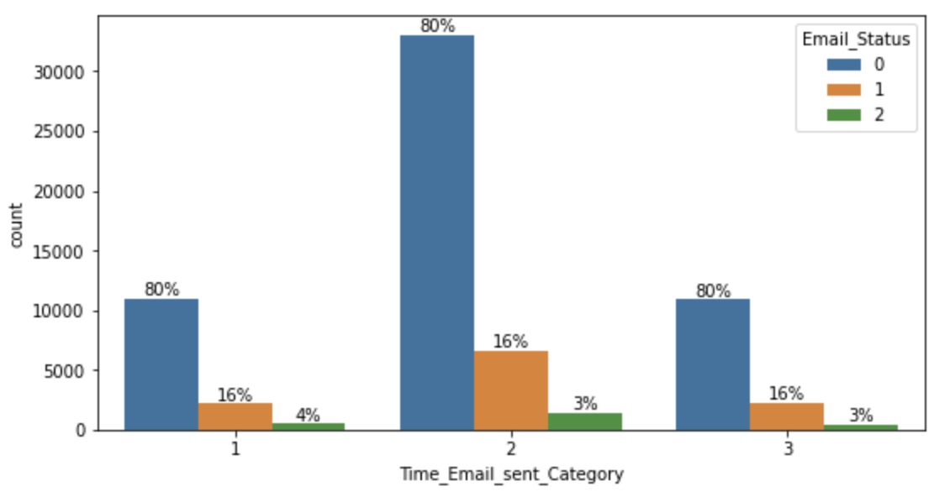
Analysis of Categorical Features
Time_Email_Sent_Catagory
Time Email Sent has no influence over Email_Status

Slide 12
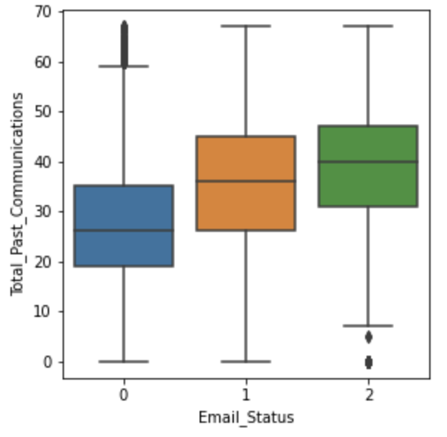
Analysis of Continous Features
Total_Past_Communications
As no. of past communication is increasing, Email is less ignored

Slide 13
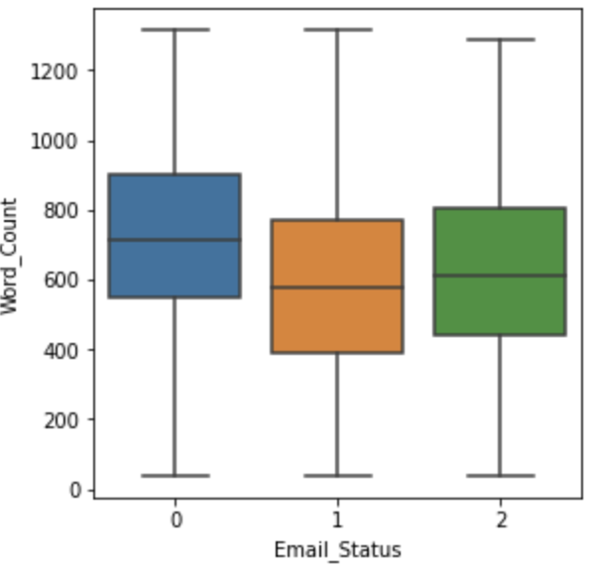
Analysis of Continous Features
Word_Count
No one is interested in reading Emails that are too long!!

Slide 14
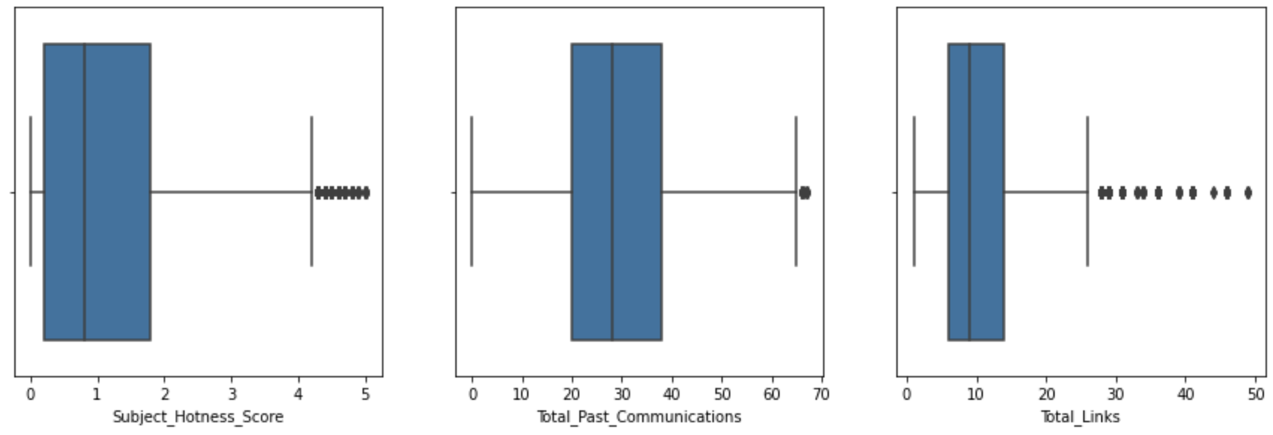
Analysis of Continous Features
Outliers in different continuous features

Slide 15
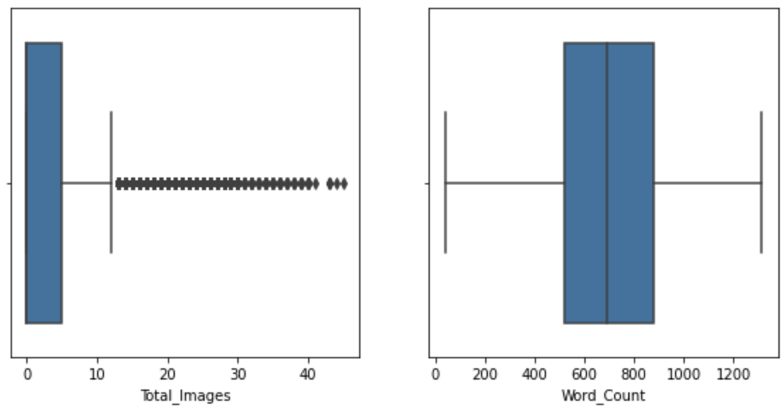
Analysis of Continous Features
Outliers in different continuous features

Slide 16
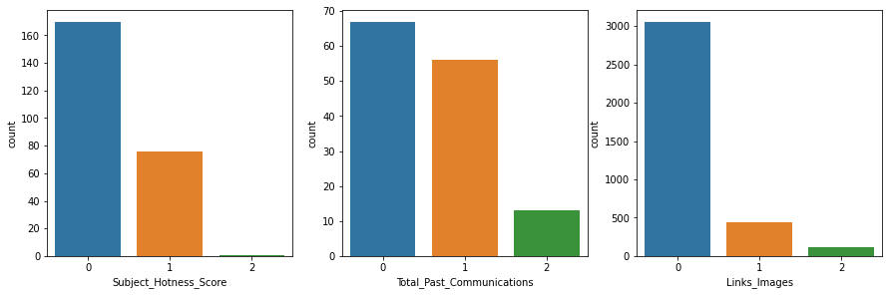
Outlier Treatment
More than 5% of data in minority classes is outlier

Slide 17
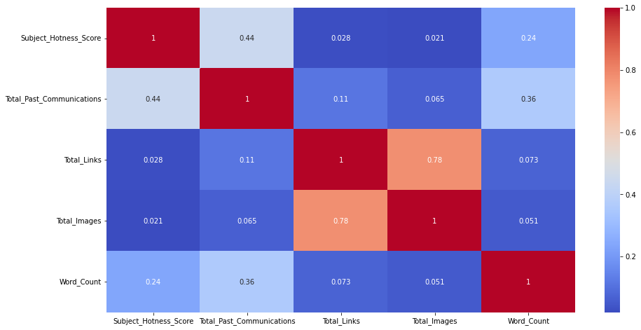
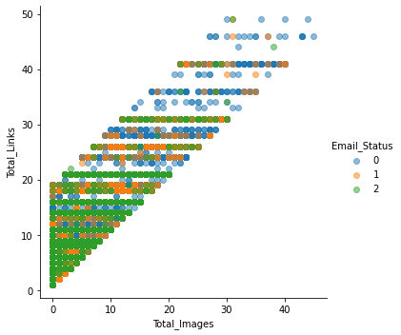
Feature Engineering
Combining Total_Images and Total_Links:
High positive correlation observed and hence Links_Images = Total_Images + Total_Links

Slide 18
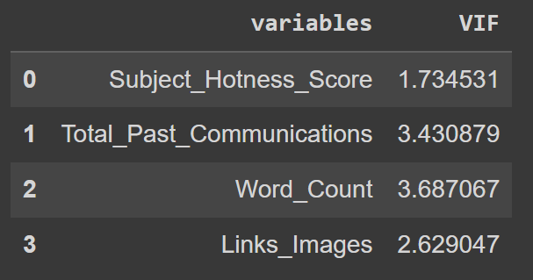
Feature Engineering
Multicollinearity Check:
Multicollinearity checked using VIF Factor Why ?
Variables with high multicollinearity can adversely affect the model and removing highly correlated independent variables can help in reducing curse of dimensionality as well
We can observe that all numerical variables are within the threshold

Slide 19
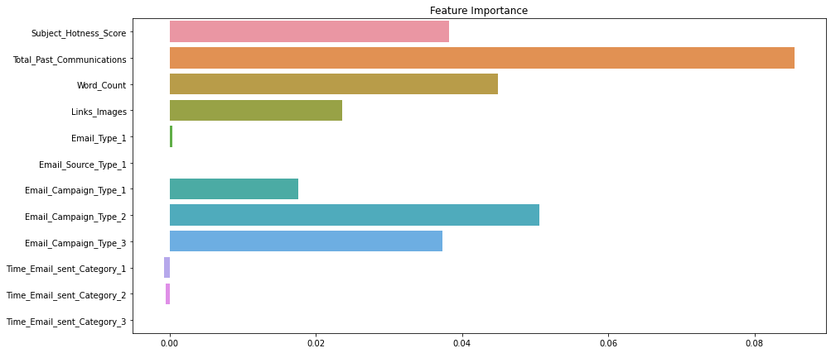
Feature Engineering
3. Understanding Feature Importance:

Slide 20
Feature Engineering
3. Understanding Feature Importance:
The concept used to understand feature importance is Information Gain. Why?
It explains which feature has maximum impact in classification based on the notion of Entropy.
It works well for numeric as well as categorical data
From the graph we understand that Total_Past_Communications and Email_Campaign_Type have high importance.
Time_Email_Sent_Category and Customer_Location are not important and hence we decide to drop the feature.

Slide 21
Feature Engineering
3. Understanding Feature Importance:
Numerical variables were scaled using MinMaxScaler. Why?
The numerical features of the dataset do not have a certain range and they differ from each other.
Categorical variables were encoded using One-Hot Encoding. Why?
This method changes categorical data to a numerical format and enables you to group your categorical data without losing any information.

Slide 22
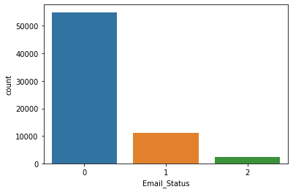
Understanding Target Variable
The target variable consists of 3 classes:
0 - ignored - 54941
1 - read - 11039
2 - acknowledged - 2373
Target Variable was highly imbalanced.

Slide 23
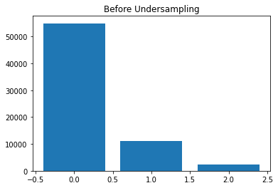
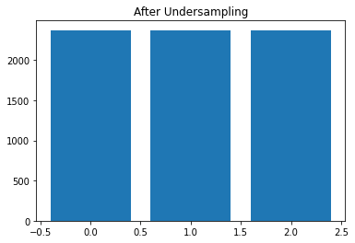
Handling Imbalance Data
Undersampling Technique:
Technique used was Random UnderSampler.
Created balanced data with 2373 records for each class.
Why it didn’t work?
Created baseline models with undersampled data and it
was observed that they underperformed primarily due to
loss of information.

Slide 24
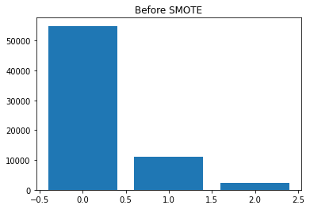
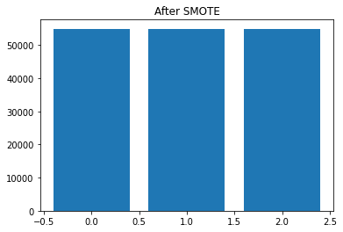
Handling Imbalance Data
2. Oversampling Technique:
Technique used was SMOTE
Created balanced data with 54941 records for each class.

Slide 25
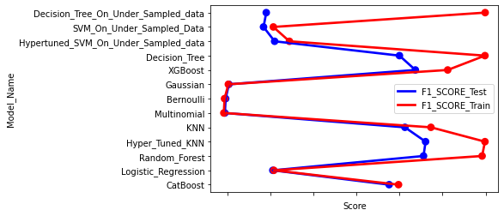
Different Models
Evaluation Metrics:
F1_Score

Slide 26
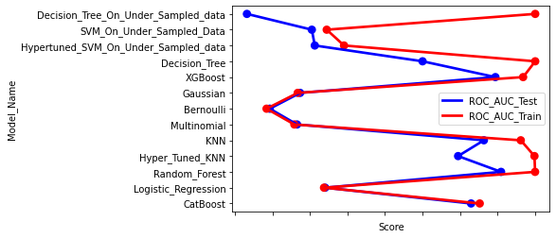
Different Models
Evaluation Metrics:
ROC_AUC_Score

Slide 27
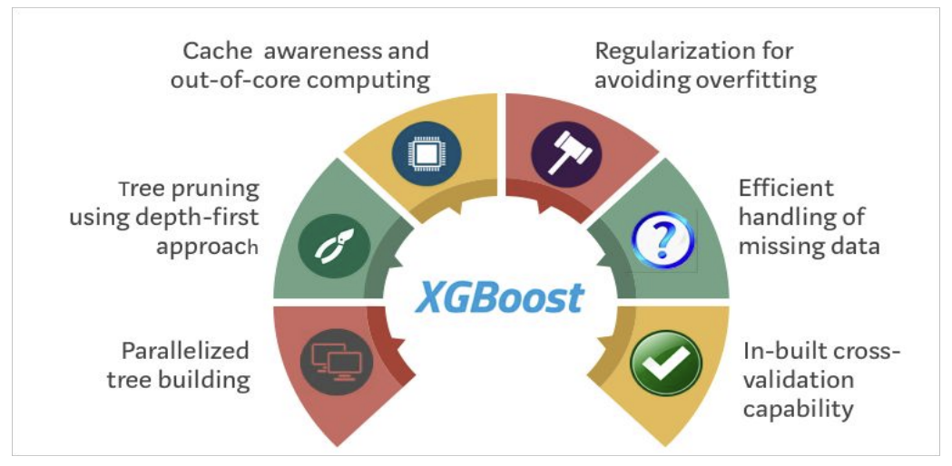
Winner Model
XGBoost:
Robust to outliers.
Supports regularization.
Works well on small to medium dataset.
F1 score for train & test set were 89% & 81% respectively.

Slide 28
Conclusion
In EDA, we observed that Email_Campaign_Type was the most important feature. If your Email_Campaign_Type was 1, there is a 90% likelihood of your Email to be read/acknowledged.
It was observed that both Time_Email_Sent and Customer_Location were insignificant in determining the Email_status. The ratio of the Email_Status was same irrespective of the demographic location or the time frame the emails were sent on.
As the word_count increases beyond the 600 mark we see that there is a high possibility of that email being ignored. The ideal mark is 400-600. No one is interested in reading long emails !
For modelling, it was observed that for imbalance handling Oversampling i.e. SMOTE worked way better than undersampling as the latter resulted in a lot of loss of information.
Based on the metrics, XGBoost Classifier worked the best giving a train score of 89% and test score of 81% for F1 score.

Slide 29
Challenges
Choosing the appropriate technique to handle the imbalance in data was quite challenging as it was a tradeoff b/w information loss vs risk of overfitting.
Overfitting was another major challenge during the modelling process.
Understanding what features are most important and what features to avoid was a difficult task.
Decision making on missing value imputations and outlier treatment was quite challenging as well.

Slide 30
Thank You

